Slide 1
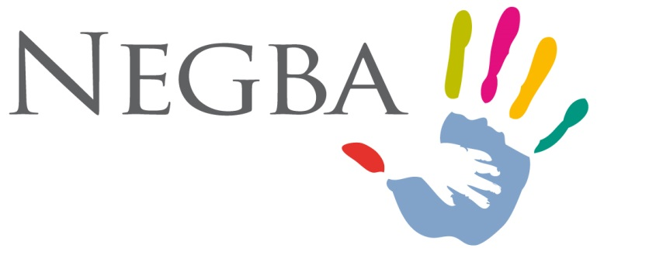
NEGBA A Network of Houses of Hope for Children At-Risk
NEGBA © 2013

Slide 2
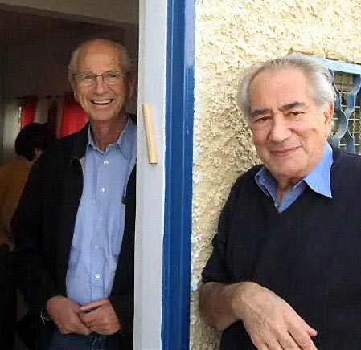
About NEGBA
NEGBA was founded in 2006 by a small group of French Israelis concerned for Israel's youth.
NEGBA means "southward." Negba launched its activities in Israel's southern region, and continues to focus important initiatives in Beersheva.

Slide 3
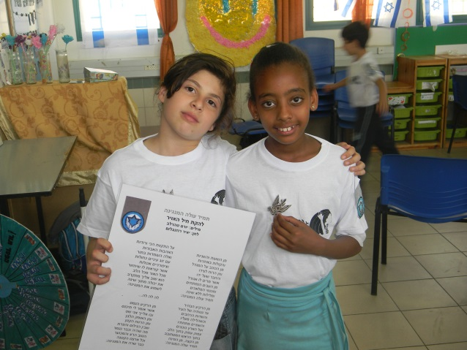
About NEGBA
NEGBA is a community based, lay driven organization providing after-school educational and social programs for Israel's children at-risk and teens aged 6 – 18.
NEGBA aims to help children at-risk regardless of race, creed or color.

Slide 4
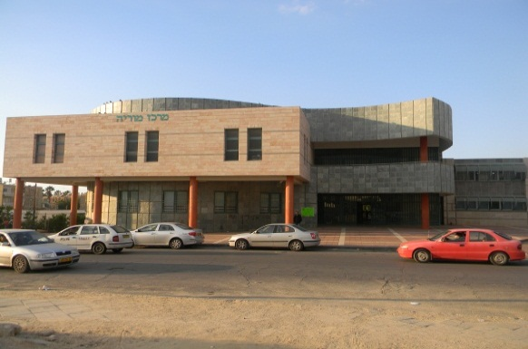
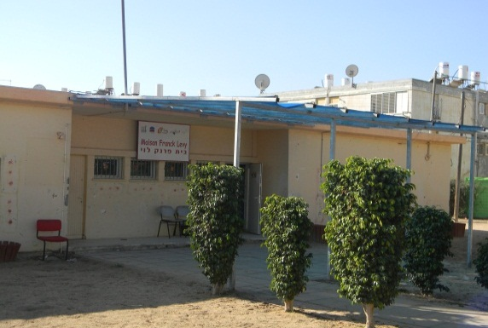
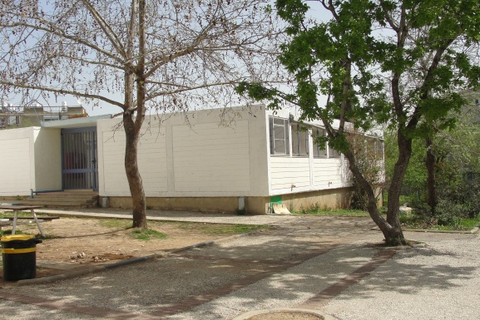
About NEGBA
NEGBA operates after-school Houses of Hope and a Teen Club of Hope, which serve as daily havens for vulnerable youngsters where they are nurtured in a warm but disciplined family environment, fed a nutritious hot meal, receive intense individualized academic tutoring and participate in structured social activities.
« Les Cigognes »
Beersheva
« Franck Levy »
Beersheva
« Bernard & Marianne Picard » Jerusalem

Slide 5
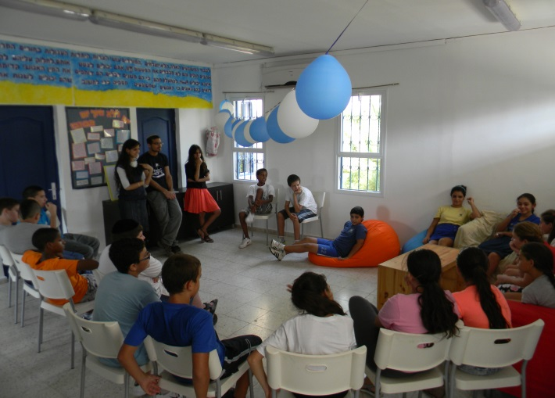
About NEGBA
NEGBA proactively intervenes as early as possible in the care of children at-risk when they are most flexible and can be influenced positively.
NEGBA reaches out to teens during the critical adolescent "gap" years of 13-15
overlooked by most governmental
programs for youth at-risk.

Slide 6
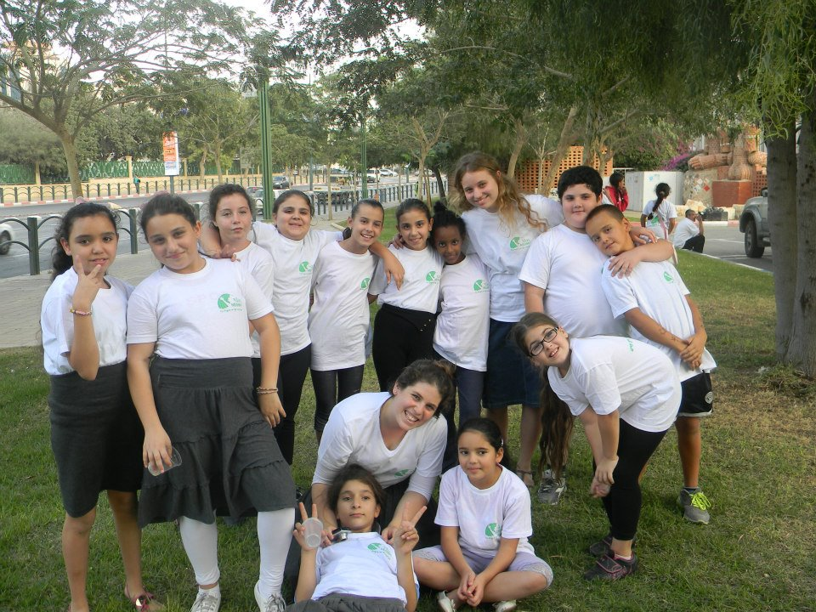
About NEGBA
NEGBA also runs a summer camp for children at-risk.
NEGBA operates its Hope Foundation which offers emergency assistance to participating children's families.

Slide 7
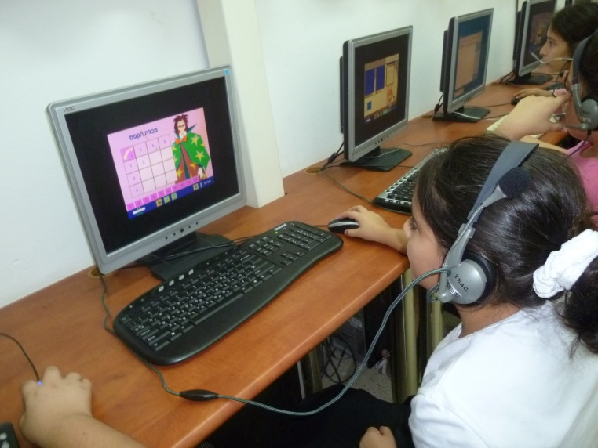
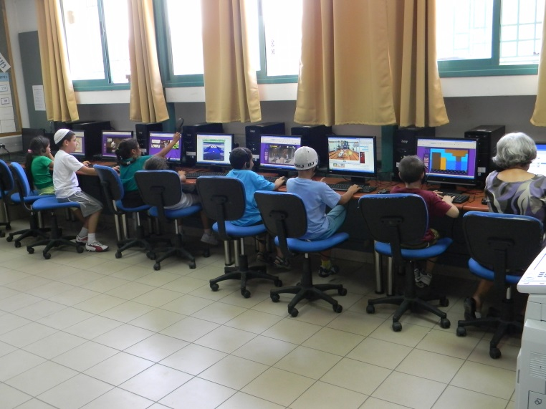
The NEGBA Advantage
NEGBA uses advanced educational software to strengthen the academic achievements of its children.

Slide 8
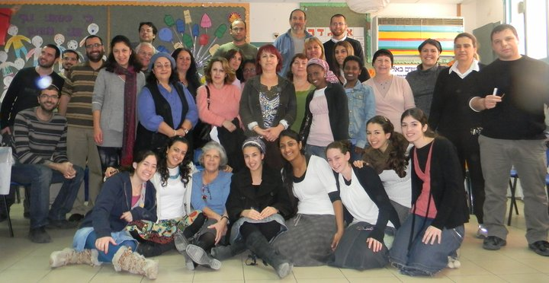
The NEGBA Advantage
NEGBA is run by a dedicated core professional paid staff filling 21 full-time equivalent positions. 40 committed professional volunteers assist in many capacities of service delivery.
NEGBA is overseen by a highly active and talented board using business standards,
allowing for transparent,
efficient and fast operation.

Slide 9
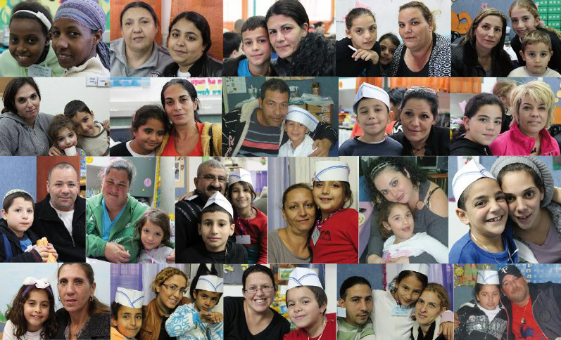
The NEGBA Advantage
NEGBA engages parents as partners in the care of their children at-risk.

Slide 10
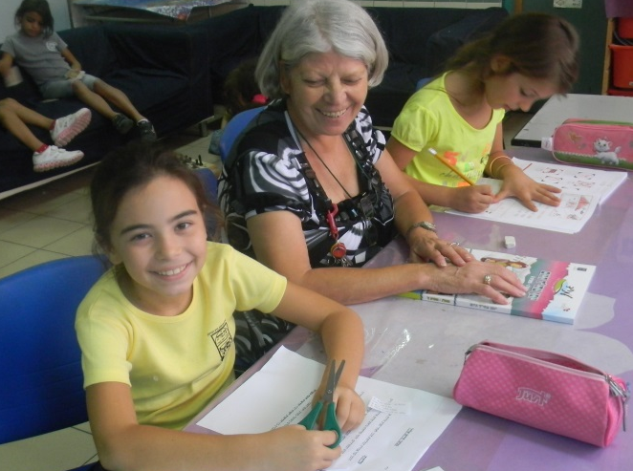
A Bright Future
NEGBA facilitates the academic success of Israel's children at-risk and fosters their healthy social and psychological well-being. Negba's children are nurtured to excel in some area- whatever area they choose.
NEGBA accompanies its children and youth to the onset of adulthood, be it army or
national service, university study
or employment.

Slide 11
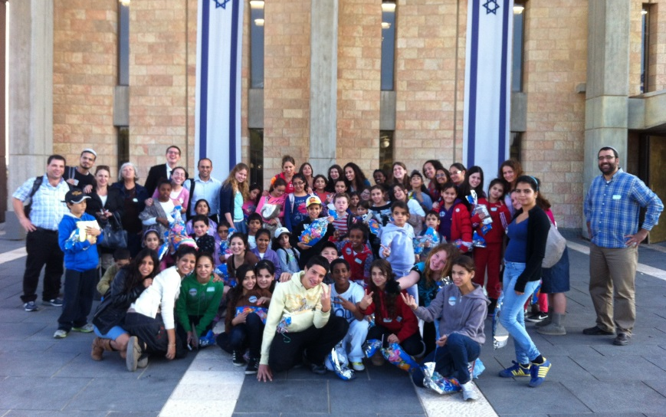
About NEGBA
NEGBA assists over 200 youth and their families each year.
NEGBA enters in contractual partnerships with state and municipal welfare and education authorities in each city of operation. Only projects that are sustainable are launched.

Slide 12
About NEGBA
NEGBA is an approved Israeli charity by the PEF Israel Endowment Funds, Inc. Donations to NEGBA are tax-deductible in the USA, Israel and France.
NEGBA exists on donations and planned gifts, and receives support from Israel's Ministries of Education and Welfare. It has an annual operating budget of USD $1.3 million.

Slide 13
For More Information
Head Office:
91 Avraham Avinu Street, POB 18001
Beersheva, 84140 Israel
Tel: +972.8.648.7684 * Fax: +972.8.648.2405
Email: negbainfo@gmail.com
Daniel Sheer, Director of Public Relations, North America
Email: daniel.prna.negba@gmail.com
www.negba.org
www.facebook.com/AssociationNegba

